Slide 1

DATA ANALYSIS ESSENTIALS
Loan Prediction System
Review 1 — Problem Statement, Dataset & Initial Progress
Submitted by:
B. Rohith — 25B11DS045
Ali Raza Hasan — 25B11DS016
K. Anand Sai — 25B11DS286
Vishnu Vardhan — 25B11DS212

Slide 2

Team Members & Responsibilities
Name | Responsibility
K. VISHNU VARDHAN | Dataset selection and data understanding
K.ANAND SAI | Data collection and preprocessing
ALI RAZA HASAN | Exploratory data analysis (EDA)
B.ROHITH | Documentation and presentation
.

Slide 3
Problem Statement
Problem Statement
Loan approval depends on multiple applicant and financial factors.
Banks need to analyze applicant information to understand loan approval patterns.
Factors such as income, loan amount, CIBIL score, and asset values may influence approval.
The project analyzes historical loan data to identify patterns between approved and rejected applications.
Review-1 focuses on data collection, preprocessing, and exploratory data analysis (EDA) as the foundation for future prediction.
Problem: Analyze and prepare loan application data to identify factors associated with loan approval.
Problem: Analyze and prepare loan application data to identify factors associated with loan approval.

Slide 4
01 · OBJECTIVES
Project Objectives
Analyze the loan application data
Understand applicant information such as income, loan amount, education, CIBIL score, and asset values.
Clean and Preprocess the data
Identify and handle missing values and prepare the data for analysis.
Explore the loan approval patterns
Use charts and visualizations to understand how different factors are related to loan approval.
Identify important approval factors
Compare loan approval patterns based on education, self-employment status, CIBIL score, and financial features.
• Prepare data for future prediction
Organize the cleaned dataset for future analysis and prediction.

Slide 5
02 · DATASET SELECTION
Dataset selection
We selected a Loan Prediction dataset containing applicant information and loan approval status. The dataset is used to understand the factors associated with loan approval.
Key Features
Dataset Selected: Loan Prediction Dataset Source: Kaggle File format: CSV Total records: 4,269 Total attributes: 13 Contains: Numerical and categorical features Target variable: Loan_Status (Y = Approved, N = Rejected) Suitable for: Data preprocessing, EDA and loan prediction analysis
ApplicantIncome – applicant's income
LoanAmount – requested loan amount
Credit_History – credit history
Education – education level
Self_Employed – employment status
Property_Area – property location
The dataset provides applicant-level information that can be cleaned, explored and visualized to identify patterns related to loan approval.

Slide 6
03 · DATA COLLECTION
Dataset collection
Data Collection Process
•Loan Prediction dataset downloaded from Kaggle in CSV format
•Dataset imported into Google Colab
•Pandas used to read the CSV file
•Data stored in a Pandas DataFrame
•Initial records inspected using head()
•Dataset structure verified using info()
Process
Kaggle → CSV → Google Colab → Pandas DataFrame → Data Analysis

Slide 7
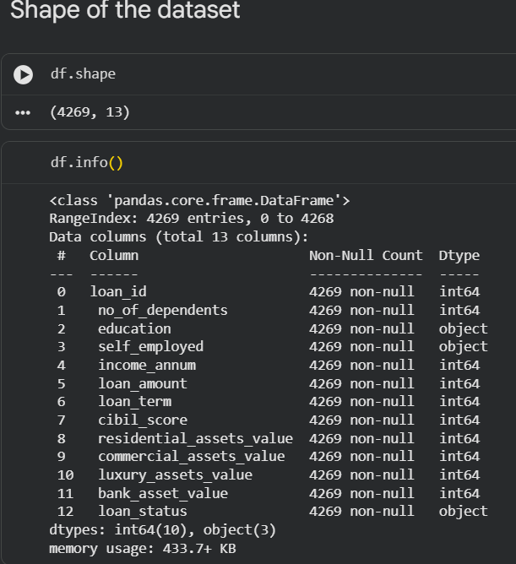
02 · DATASET UNDERSTANDING
Dataset understanding
Loaded dataset using Pandas.
Inspected sample records using head() and tail().
Checked dataset structure using df.info().
Identified column names and data types.
Verified dataset size: 4,269 rows × 13 columns.
Identified important loan-related features for analysis.

Slide 8
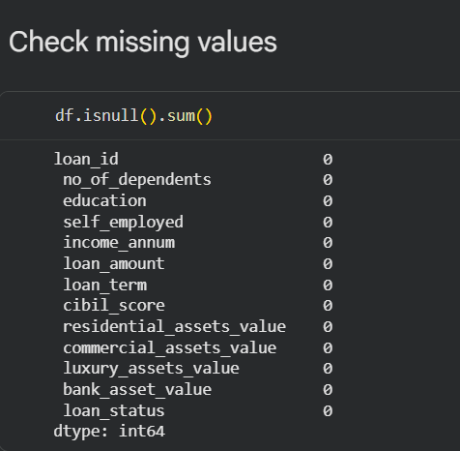
03 · PREPROCESSING
Data Preprocessing & Cleaning
Preprocessing Steps
•Checked for missing values.
•Checked for duplicate records — 0 duplicates found
•Verified data types.
•Checked the dataset structure.
•Verified numerical and categorical features.
•Confirmed that all 4,269 records have complete values.
•Prepared clean data for loan prediction analysis.
Functions Used
• df.isnull().sum() — check missing values
• df.duplicated().sum() — check duplicate records
• df.drop_duplicates() — remove duplicate records
• df.info() — check data types and structure
• df.shape — verify dataset dimensions

Slide 9
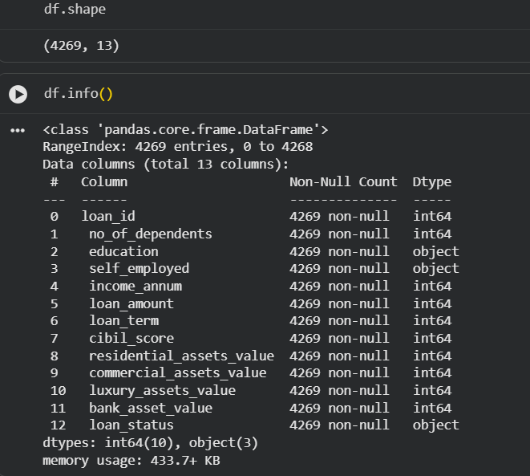
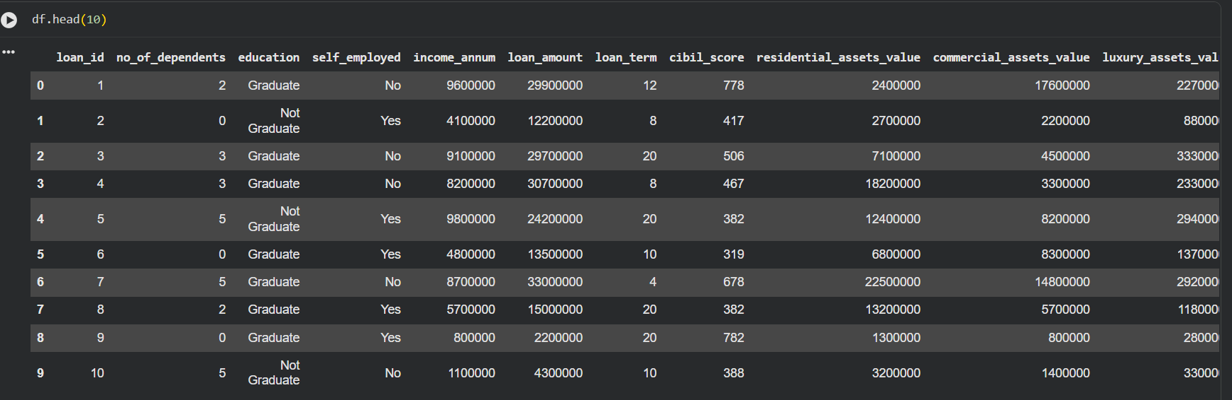
Initial Dataset Implementation
Basic Dataset Inspection
Functions Used for Initial Analysis
df.head() → inspected sample records
df.info() → checked structure and data types
df.shape → verified dataset dimensions
df.columns → identified available features
df.dtypes → identified data types
Implementation Result: Successfully loaded and inspected 4,269 records and 13 features using Pandas.

Slide 10
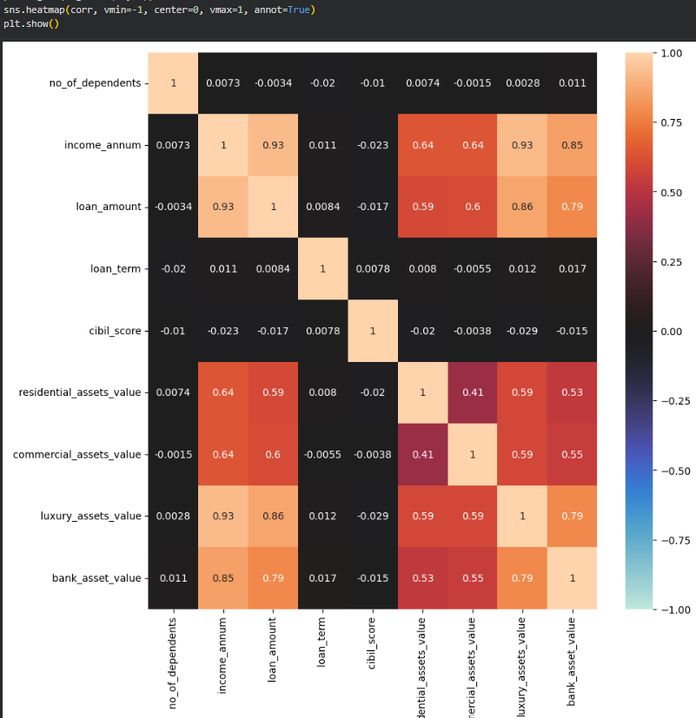
Exploratory Data Analysis (EDA) – Correlation Analysis
Analyzed relationships between numerical features.
Used correlation analysis to identify relationships between variables.
Visualized correlations using a heatmap.
Income and loan amount show a strong positive correlation (0.93).
Asset values also show positive relationships with income and loan amount.
Credit score has relatively weak correlation with the other numerical variables.
numeric_cols = df.select_dtypes(include='number').columns.drop('loan_id')
corr = df[numeric_cols].corr()

Slide 11
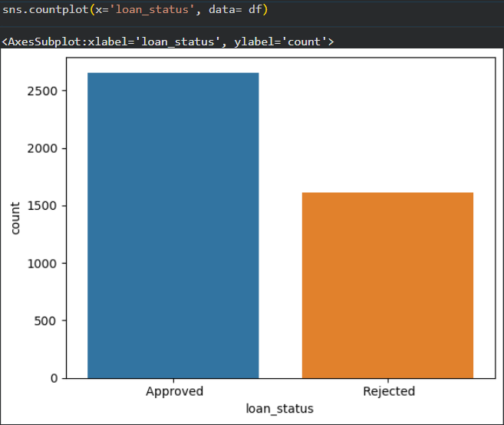
Loan Status Distribution
Most loan applications were approved.
Approved applications are higher than rejected applications.
The dataset contains both approved and rejected applications.
Loan status is the target variable for prediction.

Slide 12
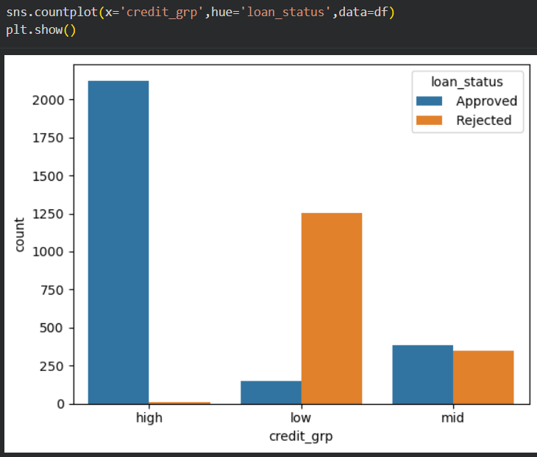
Credit Group Analysis
• Compared loan applicants across different credit score groups.
• High-credit applicants have significantly more approved loans.
• Low-credit applicants have more rejected loans.
• Mid-credit applicants show a more balanced distribution.
• Credit score shows a strong relationship with loan status and can be considered an important feature for loan prediction.

Slide 13
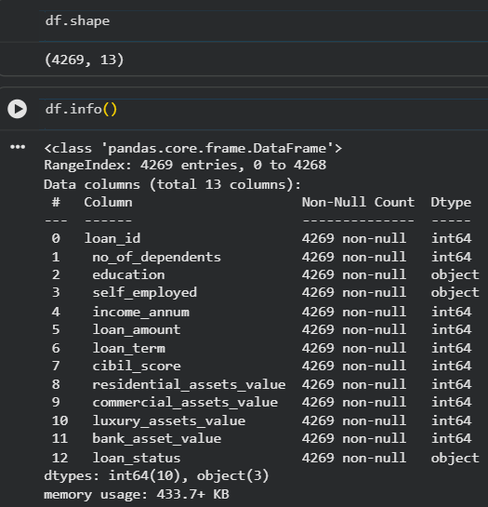
Initial Implementation & Progress
Loaded and explored the loan dataset using Pandas.
Verified dataset structure, features and data types.
Checked for missing values.
Checked for duplicate records.
Performed Exploratory Data Analysis (EDA).
Analyzed loan status distribution.
Studied relationships between numerical features using correlation analysis.
Created visualizations using Matplotlib and Seaborn.

Slide 14
Project Workflow
1. Dataset Collection Dataset collected in CSV format and loaded into Google Colab using Pandas.
2. Data Preprocessing Checked missing values, duplicate records, data types, and dataset structure.
3. Exploratory Data Analysis (EDA) Analyzed loan status, numerical features, and relationships between variables.
4. Visualization & Analysis Created bar charts and correlation heatmap to identify important patterns.
5. Loan Prediction – Next Phase Next Phase: Build and evaluate a loan prediction model using the preprocessed dataset.

Slide 15
WRAPPING UP
Conclusion & Future Scope
Project Progress
• Loan dataset was collected and explored.
• Data quality, missing values and duplicates were checked.
• EDA and visualizations were performed.
• Important relationships between features were identified.
Future Scope
• Apply feature encoding and scaling.
• Select important features.
• Build a machine learning model for loan prediction.
• Evaluate and improve model performance.

